Slide 1
Autologous Bone Marrow Derived Intrathecal Stem Cell
Transplant for 250 Autistic Children
Univ.Doz.Dr.med. Georg S. Kobinia

Slide 2
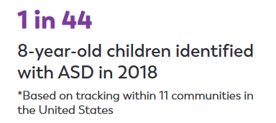
PREVALENCE among 8-year old children
Prevalence 2018 (USA)
at least 2.3%
3%
Prevalence increases by 1%
every 10 years!!!!
2%
It is often criticized that the prevalence has increased due to increased testing in recent decades...
Maybe before 2013, but was there really more testing after 2013 [The Diagnostic and Statistical Manual version 5 (DSM-5) was published by the American Psychiatric Association, 2013], or is annual testing really increasing as much as the prevalence?
Such an enormous increase in patients excludes a purely genetic cause of autism! There is not a single gene causing autism, but certain correlations between genetic aberration and autism exist.
1%
Data from the CDC (USA)
https://www.cdc.gov/ncbddd/autism/data.html
https://www.cdc.gov/ncbddd/autism/addm-community-report/documents/ADDM-Community-Autism-Report-12-2-021_Final-H.pdf

Slide 3
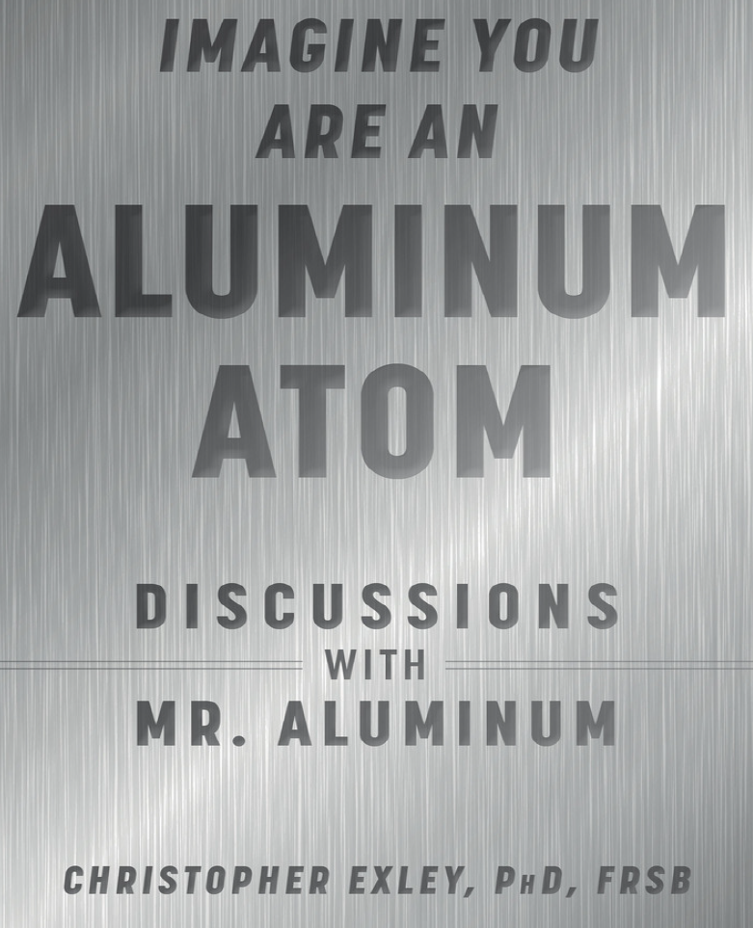
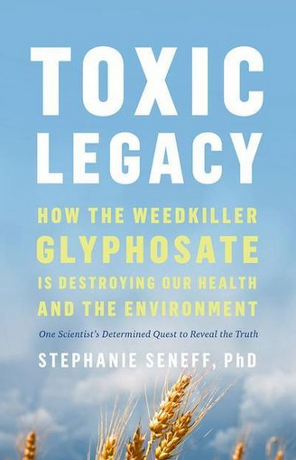
ETIOLOGY
Autism-related difficulties remain untreated throughout life and often require ongoing support.
To date no clear and definitive cause for ASD is evident.
Thus, it still is believed that no curative therapy is available to treat the disease.
?
Genetic factors
having an immediate family member who is autistic
certain genetic mutations
Fragile X syndrome and other genetic disorders
Environmental factors
birth-related factors
  C-section
  fetal exposure to the drugs valproic acid or thalidomide (Thalomid)
  being born to older parents
  poor growth of the fetus in the womb
  lack of oxygen during birth/cesarean section
  premature birth
  a maternal history of viral infections
  primary (from the mother) or
  secondary (from environmental influences) mitochondrial dysfunction
  artificial insemination ?
exposure to
  toxic metals (z.B. Pb, Hg, Cadmium,…) and especially aluminum
  environmental toxins (z.B. glyphosate)

Slide 4
GLYPHOSATE and ALUMINUM
„Partners in Crime“ (Stefanie Seneff)
(1) Glyphosate disrupts gut bacteria, leading to an overgrowth of Clostridium difficile. Its toxic product (p-cresol) is linked to autism in both human and mouse models and enhances uptake of aluminum via transferrin. Anemia, a result of both aluminum-disruption of heme and impaired heme synthesis by glyphosate, leads to hypoxia.
(2) Glyphosate chelates aluminum, allowing ingested aluminum to bypass the gut barrier. This leads to anemia-induced hypoxia, promoting neurotoxicity and damaging the pineal gland
  Both, glyphosate and aluminum disrupt cytochrome P450 enzymes, which are involved in melatonin metabolism.

Slide 5
 | Cell-based therapy | Behavioural therapy | Drug therapy
SAFETY | no serious AE^{1,2} Not one single serious AE has been reported so far!!!!!! | unknown | serious AE³
EFFECTIVITY | sig. better CARS*^{1,2} *typical abnormalities in perception and language, features of impaired motor control and autonomic functions as well as social and play behavior Parents reported an improvment of Ø20 points with the ATEC!!! | sig. better ‚social functions‘⁴ | sig. better regarding stereotypical behavior and social communication³
COSTS | €7.000-15.000/treatment (1-2x per lifetime) | $206.337⁶ per total lifetime costs £20.000-30.000⁵ per QALY (quality-adjusted life year with ABA) | prescription drugs (Germany) €366 per year⁷
per lifetime (Ø life expectancy: 65 years) | €7.000-30.000 (2022) | €1.495.000-2.275.000 (2017) €209.800 (2003!) | €23.790 (2016)
¹ Villarreal-Martínez L, González-Martínez G, Sáenz-Flores M, Bautista-Gómez AJ, González-Martínez A, Ortiz-Castillo M, Robles-Sáenz DA, Garza-López E. Stem Cell Therapy in the Treatment of Patients With Autism Spectrum Disorder: a Systematic Review and Meta-analysis. Stem Cell Rev Rep. 2022 Jan;18(1):155-164. doi: 10.1007/s12015-021-10257-0. Epub 2021 Sep 13. PMID: 34515938.
² Qu J, Liu Z, Li L, Zou Z, He Z, Zhou L, Luo Y, Zhang M, Ye J. Efficacy and Safety of Stem Cell Therapy in Children With Autism Spectrum Disorders: A Systematic Review and Meta-Analysis. Front Pediatr. 2022 May 4;10:897398. doi: 10.3389/fped.2022.897398. PMID: 35601435; PMCID: PMC9114801.
³ D'Alò GL, De Crescenzo F, Amato L, Cruciani F, Davoli M, Fulceri F, Minozzi S, Mitrova Z, Morgano GP, Nardocci F, Saulle R, Schünemann HJ, Scattoni ML; ISACA Guideline Working Group. Impact of antipsychotics in children and adolescents with autism spectrum disorder: a systematic review and meta-analysis. Health Qual Life Outcomes. 2021 Jan 25;19(1):33. doi: 10.1186/s12955-021-01669-0. PMID: 33494757; PMCID: PMC7831175.
⁴ Darling SJ, Goods M, Ryan NP, Chisholm AK, Haebich K, Payne JM. Behavioral Intervention for Social Challenges in Children and Adolescents: A Systematic Review and Meta-analysis. JAMA Pediatr. 2021 Dec 1;175(12):e213982. doi: 10.1001/jamapediatrics.2021.3982. Epub 2021 Dec 6. PMID: 34661613; PMCID: PMC8524357.
⁵ Hodgson R, Biswas M, Palmer S, Marshall D, Rodgers M, Stewart L, Simmonds M, Rai D, Le Couteur A. Intensive behavioural interventions based on applied behaviour analysis (ABA) for young children with autism: A cost-effectiveness analysis. PLoS One. 2022 Aug 16;17(8):e0270833. doi: 10.1371/journal.pone.0270833. PMID: 35972929; PMCID: PMC9380934.
⁶ Ganz ML. The lifetime distribution of the incremental societal costs of autism. Arch Pediatr Adolesc Med. 2007 Apr;161(4):343-9. doi: 10.1001/archpedi.161.4.343. PMID: 17404130.
⁷ Höfer J, Hoffmann F, Dörks M, Kamp-Becker I, Küpper C, Poustka L, Roepke S, Roessner V, Stroth S, Wolff N, Bachmann CJ. Health Services Use and Costs in Individuals with Autism Spectrum Disorder in Germany: Results from a Survey in ASD Outpatient Clinics. J Autism Dev Disord. 2022 Feb;52(2):540-552. doi: 10.1007/s10803-021-04955-4. Epub 2021 Mar 17. PMID: 33728496; PMCID: PMC8813793.

Slide 6
SAFETY regarding autologous, intrathecally administered stem cell therapy
Reference | Study type | Population | Intervention | Serious AE | Non-serious procedure-related AE | Non-serious cell-related AE
Sharma et al. ¹ (2013) | open label proof-of- concept | ASD n=32 8f/24m 3-33y | BM-MSC (n=32) intrathecal (1x) | 0 | 14.2% (4/32) pain at puncture site 3.6% (1/32) spinal headache 28.6% (9/32) vomiting/nausea | 21.9% (7/32) hyperactivity 9.4% (3/32) seizures
Nguyen Thanh et al. ² (2020) | open label uncontrolled clinical trial | ASD n=30 5f/25m 3-7y | BM (n=30) intrathecal (2x) | 0 | 56.7% (17/30) AE may be related to SCI (mild fever, nausea, vomiting) 86.7% (26/30) AE related to SCI (pain, broken vein, peripheral vein masonry, slipping needle out of the vein during transplantation) | 0
Sharifzadeh et al. ³ (2020) | randomized controlled trial | ASD n=32 5f/27m 5-15y | BM-MSC (n=14) vs. control (n=18) intrathecal (2x) | 0 | 0 | 0
Sharma et al. ⁴ (2020) | open label non-randomized | ASD n=254 31f/223m 0-15y (n=230) ≥15y (n=24) | BM (n=254) (with GCSF injection) intrathecal (1x) | 0 | n=? spinal headache n=? vomiting/nausea n=? pain/bleeding at puncture sites n=? fever | 8.2% (21/254) hyperactivity 9.8% (25/254) aggressiveness 6.3% (16/254) self-injurious behavior 2.0% (5/254) seizures
Kobinia (under evaluation) | retrospective study | ASD n=408 72f/336m 2-18y | BM (n=519) intrathecal (1x) | 0 | 3.9% (20/519) pain at puncture site 9.6% (50/519) headache 14.6% (76/519) vomiting/nausea 1.5% (8/519) mild fever | 1.7% (9/519) hyperactivity
Sharma et al. ⁵ (2023) | observational clinical study | ASD n=1011 170f/841m 0-15y (n=891) ≥15y (n=120) | BM (n=1011) (with GCSF injection) intrathecal (1x) | 0 | n=? spinal headache n=? vomiting/nausea n=? pain/bleeding at puncture sites n=? fever | 0.9% (9/1011) seizures
TOTAL PROCEDURES 1606 |  |  |  | 0 | all non-serious AE were transient
Abbreviations: AE, adverse event; ASD, autism spectrum disorders; BM, bone marrow; f, female; GCSF, granulocyte colony stimulating factor; m, male; MSC, mesenchymal stromal cells; SCI, stem cell intervention; y, years.
¹ Sharma, A. et al. (2013) Autologous bone marrow mononuclear cell therapy for autism: an open label proof of concept study. Stem Cells Int 2013, 1-13.
² Nguyen Thanh, L. et al. (2021) Outcomes of bone marrow mononuclear cell transplantation combined with interventional education for autism spectrum disorder. Stem Cells Transl Med 10, 14-26.
³ Sharifzadeh, N. et al. (2020) Intrathecal autologous bone marrow stem cell therapy in children with autism: A randomized controlled trial. Asia Pac Psychiatry, e12445, 1-11.
⁴ Sharma, A. K. et al. (2020) Cell transplantation as a novel therapeutic strategy for autism spectrum disorders: a clinical study. Am J Stem Cells 9, 89-100.
⁵ Sharma, A., Gokulchandran, N., Sane, H., Kulkarni, P., Kannan, K., Shaikh, Z., Biju, H., Paranjape, A., Dsa, M., & Badhe, P. (2023). Autologous Bone Marrow Mononuclear Cell Administration in a Large Cohort Of 1011 Autism Spectrum Disorder Patients: A Clinical Study. Preprints. https://doi.org/10.20944/preprints202307.1498.v1

Slide 7
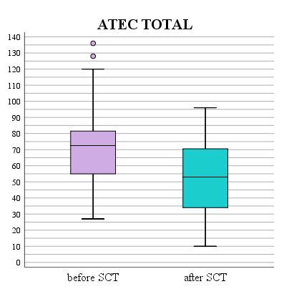
EFFECTIVENESS
regarding autologous, intrathecally administered stem cell therapy
(ATEC improvement from baseline to follow-up)
 | Nr of patients | ATEC SGI (communication) | ATEC SGII (sociability) | ATEC SGIII (sensory) | ATEC SGIV (physical) | ATEC TOTAL
before SCT | 250 | 17.6±6.6 | 15.9±7.6 | 17.3±6.6 | 21.0±10.8 | 71.5±22.9
after SCT | 250 | 14.3±6.9 | 10.6±5.9 | 12.2±6.0 | 14.8±9.6 | 52.1±22.0
 |  | p<0.001 | p<0.001 | p<0.001 | p<0.001 | p<0.001
severe autism (80-179)
p<0.001
The overall ATEC as well as the four ATEC subgroups (communication/language, social behavior, sensory/mental perception, health/physical/behavior) significantly improved with autologous stem cell transplantation!!!
moderate autism (50-79)
mild autism (21-49)
non-autistic (0-20)
The classification regarding the degree of severity of autism symptoms was according to Mahapatra et al. 2020.
Mahapatra S, Khokhlovich E, Martinez S, Kannel B, Edelson SM, Vyshedskiy A. Longitudinal Epidemiological Study of Autism Subgroups Using Autism Treatment Evaluation Checklist (ATEC) Score. J Autism Dev Disord. 2020 May;50(5):1497-1508. doi: 10.1007/s10803-018-3699-2. PMID: 30062397; PMCID: PMC7211200.

Slide 8
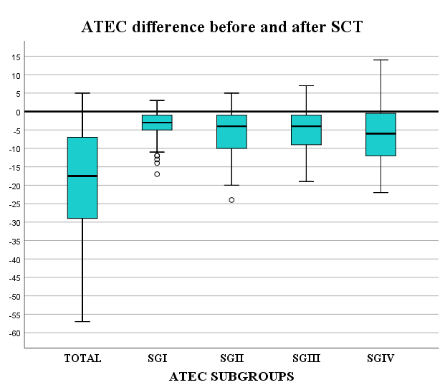
EFFECTIVENESS
regarding autologous, intrathecally administered stem cell therapy
(ATEC subgroup improvements)
ATEC-improvements:
Ø 20 ATEC points (19.5±15.5)
91.3% improvement regarding ATEC total points (1-57 points)!
  1.3% no point-change
  7.5% slight point-increase (1-6 points)
45.1% improvement regarding severity of autism symptoms

Slide 9
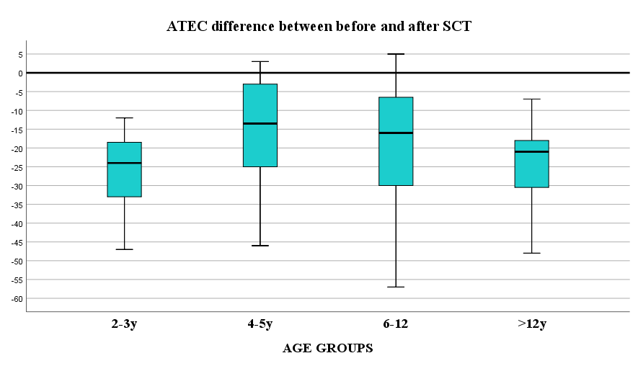
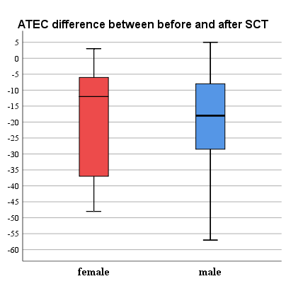
ATEC-improvement:
age-group: differences?
girl-boy: differences?
NO significant difference regarding
age-groups (p=0.328)!
NO significant differences between girls and boys (p=0.985)!

Slide 10
SUMMARY
SAFETY
NO serious AE
EFFEKTIVITY
Significant improvements regarding ATEC
  Ø 20 ATEC point improvement
  5.3% of patients drop out of being categorized as ASD
COSTS
much lower than behavioral therapy
no ongoing/lifetime therapy necessary

Slide 11
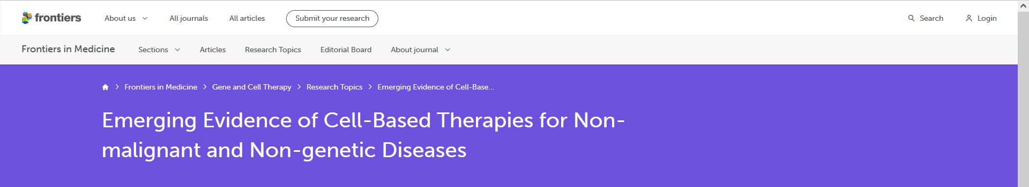
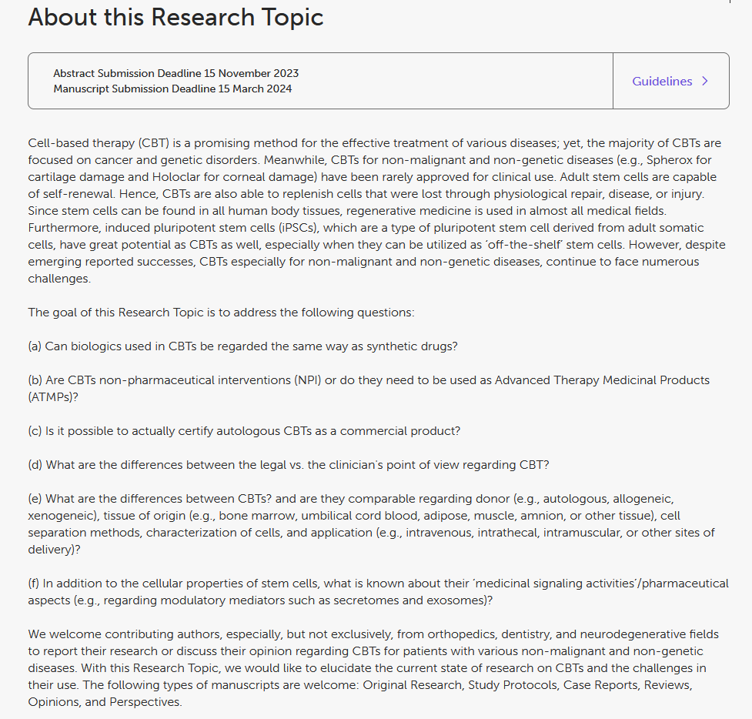
Please contribute to our research topic!
https://www.frontiersin.org/research-topics/58266/emerging-evidence-of-cell-based-therapies-for-non-malignant-and-non-genetic-diseases?utm_source=F-RTM&utm_medium=TED1&utm_campaign=PRD_TED1_T1_RT-TITLE

Slide 12
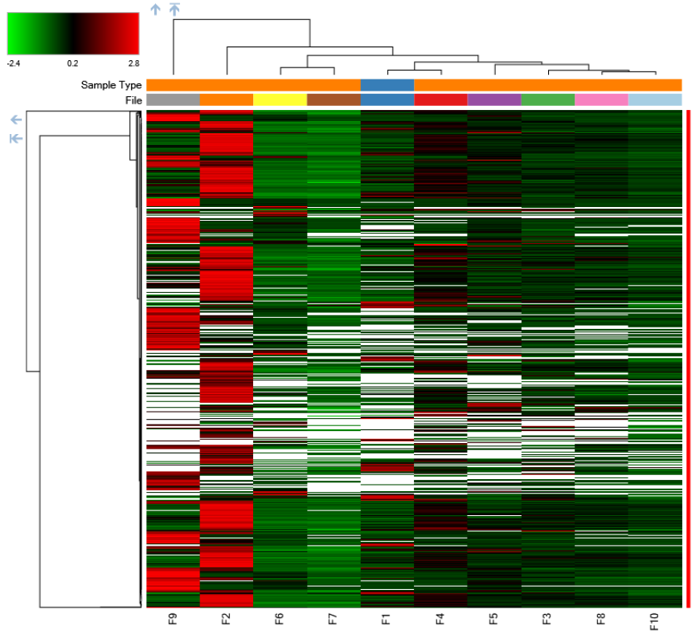
Ongoing research
in CSF
proteomic analysis →detoxification problems
metalomic analysis →high toxic metals
in urine
glyphosate →high levels
in blood
biological health index (BHI) →mitochondrial dysfunction

Slide 13
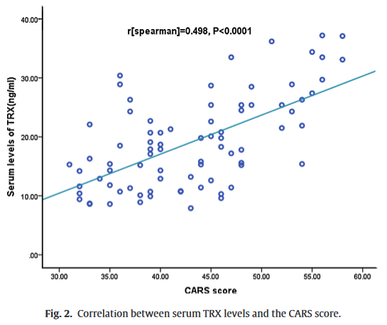
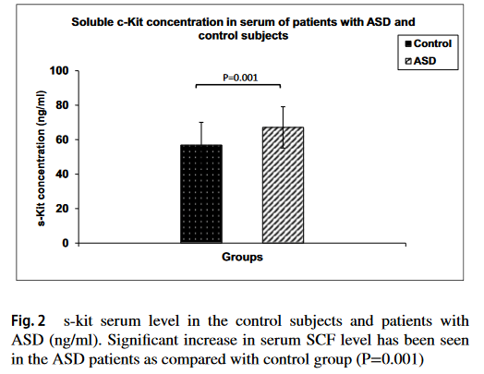
Preliminary findings:
Proteomic analysis of CSF
TXN (thioredoxin)
was significantly downregulated after SCT
KIT(=CD117)
was significantly upregulated after SCT
-repair mechanism
‘Serum levels of TRX sig. correlated with severity of ASD as defined by the CARS score.’
[Zhang QB, Gao SJ, Zhao HX. Thioredoxin: a novel, independent diagnosis marker in children with autism. Int J Dev Neurosci. 2015 Feb;40:92-6. doi: 10.1016/j.ijdevneu.2014.11.007. Epub 2014 Nov 26. PMID: 25433158.]
‚Serum cKit concentrations positively correlated with ASD severity‘
[Mashayekhi F, Shabani S, Sasani ST, Salehi Z. The association of stem cell factor and soluble c-Kit (s-cKit) receptor serum concentrations with the severity and risk prediction of autism spectrum disorders. Metab Brain Dis. 2022 Mar;37(3):619-624. doi: 10.1007/s11011-021-00883-5. Epub 2022 Jan 13. PMID: 35023029.]
Stem cell factor (SCF also known as KIT-ligand or steel factor)
=cytokine that binds to the c-kit receptor (CD117)
- serves as guidance cues that direct hematopoietic stem cells (HSCs) to their stem cell niche (the microenvironment in which a stem cell resides)
-plays an important role in HSC maintenance

Slide 14
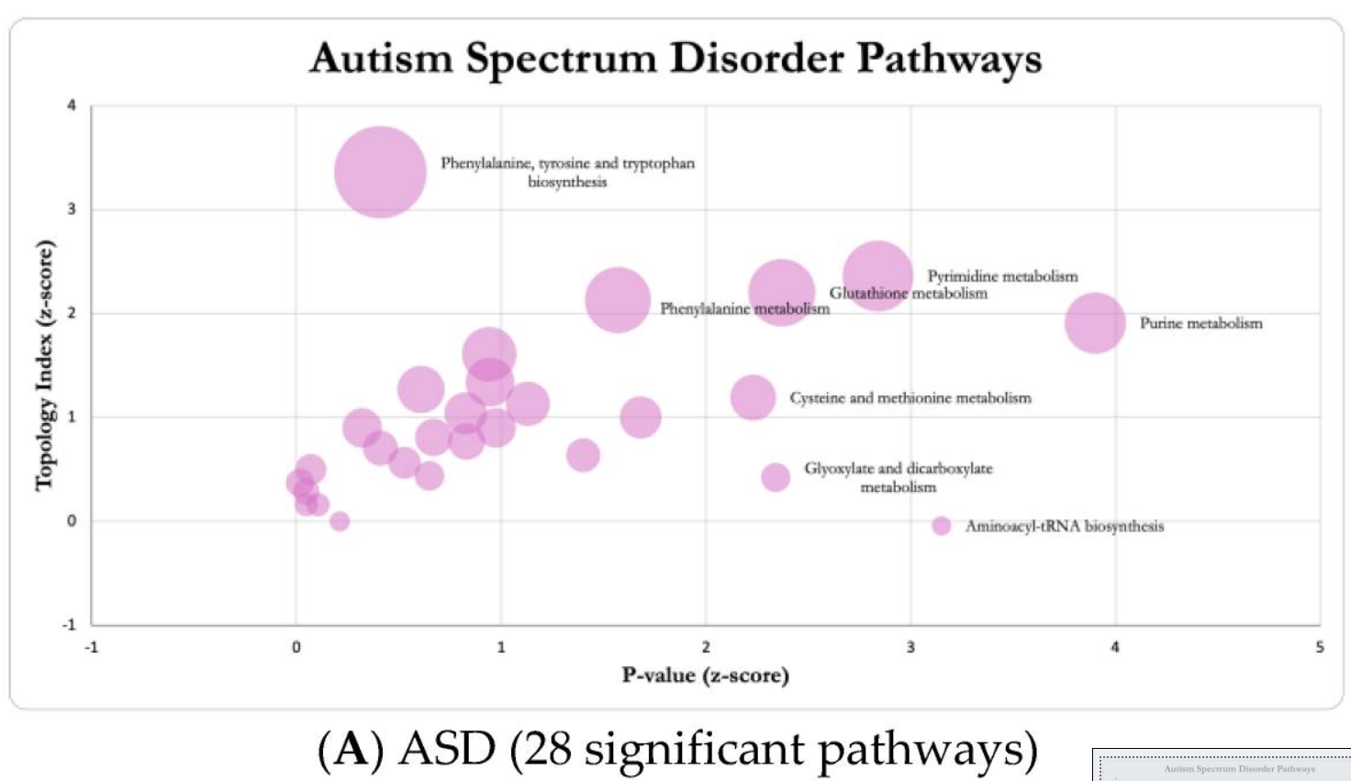
Cerebrospinal fluid analysis
[Brister D, Werner BA, Gideon G, McCarty PJ, Lane A, Burrows BT, McLees S, Adelson PD, Arango JI, Marsh W, Flores A, Pankratz MT, Ly NH, Flood M, Brown D, Carpentieri D, Jin Y, Gu H, Frye RE. Central Nervous System Metabolism in Autism, Epilepsy and Developmental Delays: A Cerebrospinal Fluid Analysis. Metabolites. 2022 Apr 20;12(5):371. doi: 10.3390/metabo12050371. PMID: 35629876; PMCID: PMC9148155.]

Slide 15
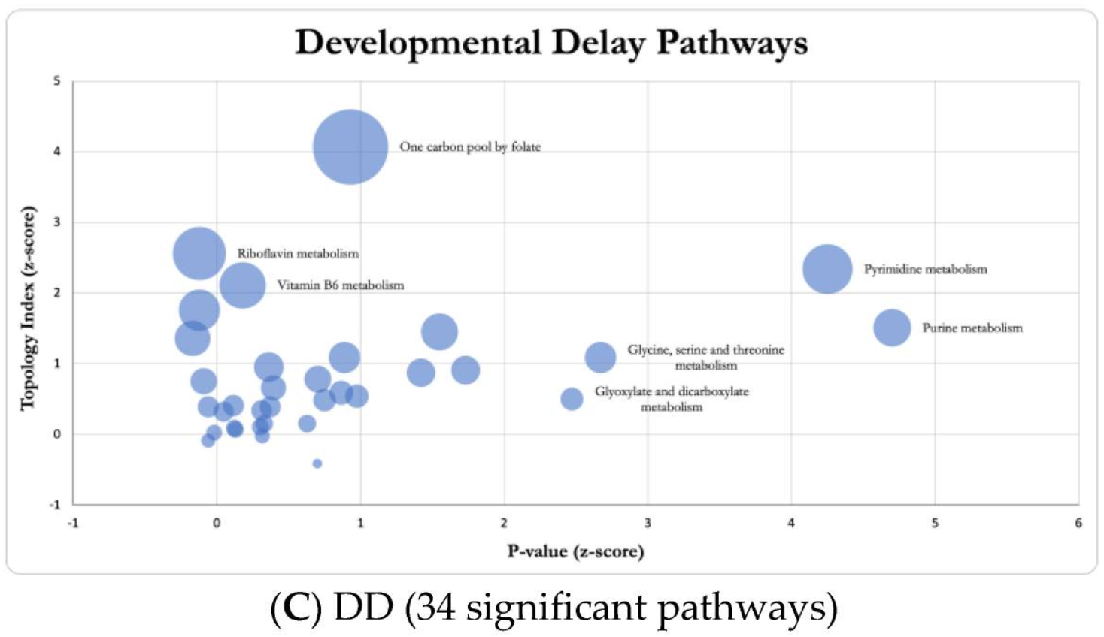
Cerebrospinal fluid analysis
[Brister D, Werner BA, Gideon G, McCarty PJ, Lane A, Burrows BT, McLees S, Adelson PD, Arango JI, Marsh W, Flores A, Pankratz MT, Ly NH, Flood M, Brown D, Carpentieri D, Jin Y, Gu H, Frye RE. Central Nervous System Metabolism in Autism, Epilepsy and Developmental Delays: A Cerebrospinal Fluid Analysis. Metabolites. 2022 Apr 20;12(5):371. doi: 10.3390/metabo12050371. PMID: 35629876; PMCID: PMC9148155.]

Slide 16
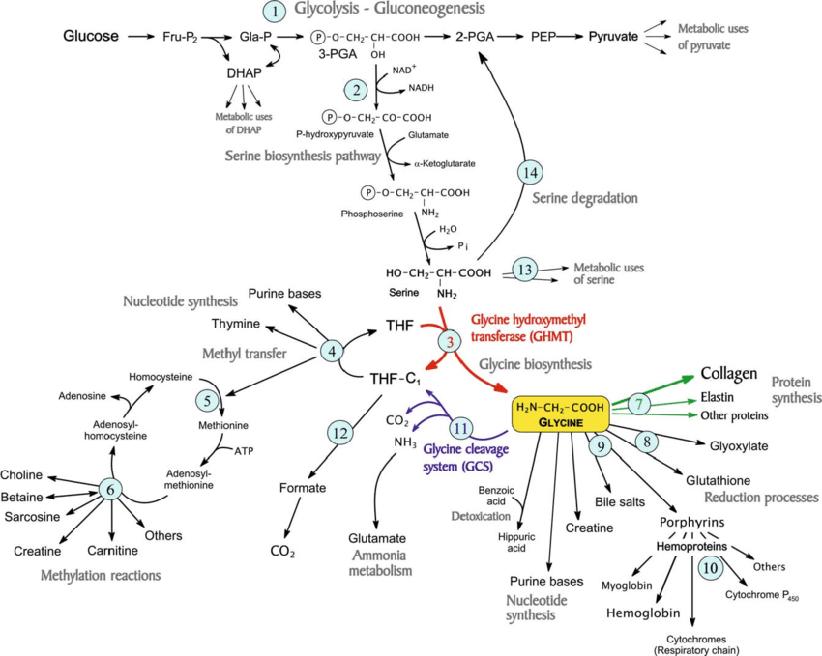
Metabolic pathways involved in the biosynthesis of glycine from serine, and its use for different metabolic functions.
Pathways:
glycolysis-gluconeogenesis system;
branch to synthesis of serine and glycine;
reaction of glycine hydroxymethyltransferase (GHMT) (EC 2.1.2.1) (shown in red), which converts serine into glycine with the transfer of a C 1 unit to tetrahydrofolate (THF);
(4-6) set of reactions of C 1 transfer, necessary for glycine synthesis as they unload the C 1 unit from THF-C1, regenerating free THF so that it can participate again in reaction 3;
(7-10) processes of biosynthesis involving glycine, especially the synthesis of collagen and other proteins (reactions 7, shown in green);
(11) irreversible reaction of the glycine cleavage system, (EC 1.4.4.2) (shown in blue), which converts glycine into a C 1 unit;
(12) oxidation of the C 1 unit to formate and CO 2 , which works as a sink of C 1 units, allowing the capability for glycine synthesis to increase;
(13) set of reactions that use serine for other processes, e.g. for choline synthesis;
(14) pathways for serine degradation.
Abbreviations: DHAP, dihydroxyacetone-phosphate; Fru-P 2 , fructose 1,6-bisphosphate; Gla-P, glyceraldehyde 3-phosphate; 3-PGA, 3-phosphoglycerate; 2-PGA, 2-phosphoglycerate; PEP, phosphoenolpyruvate; THF-C 1 , 5, 10-methylene-THF.
.

Slide 17
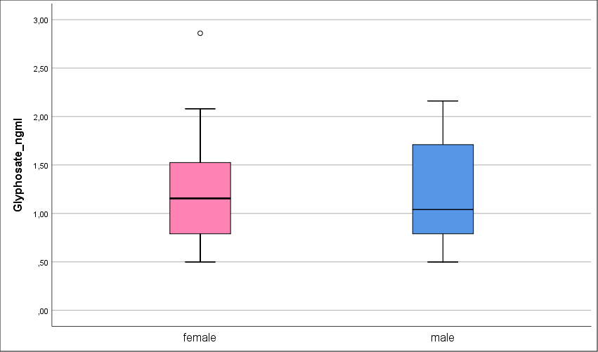
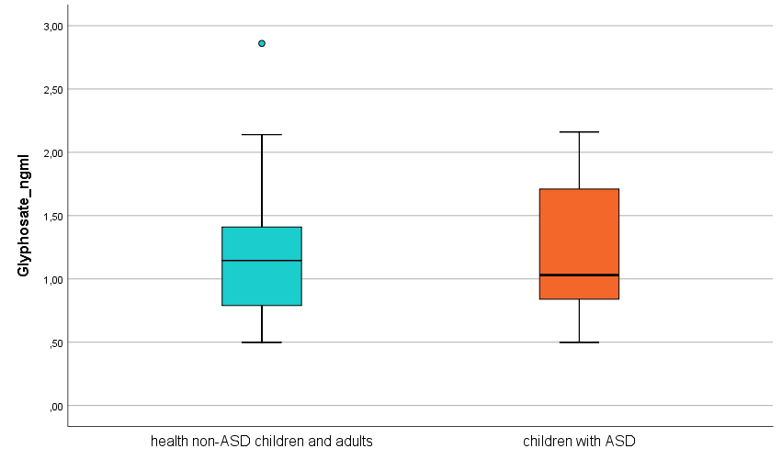
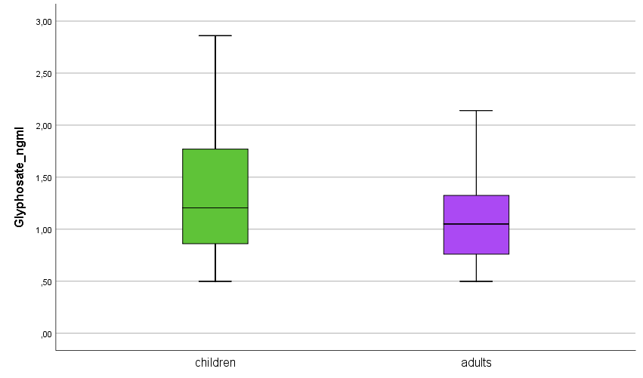
Glyphosate (urine)

Slide 18
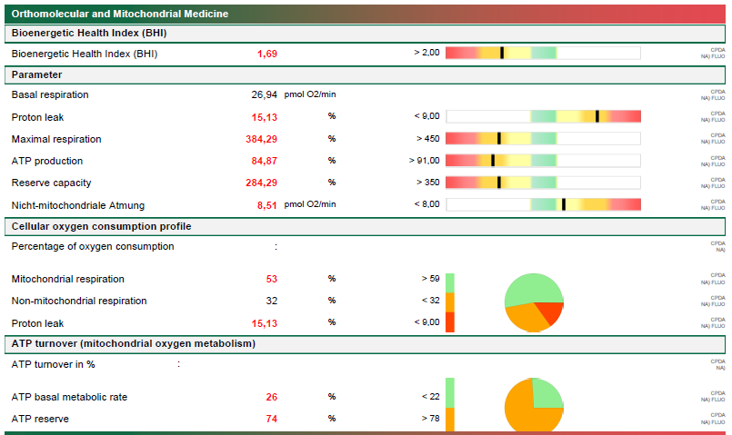
Case: BHI (prior SCT)

Slide 19
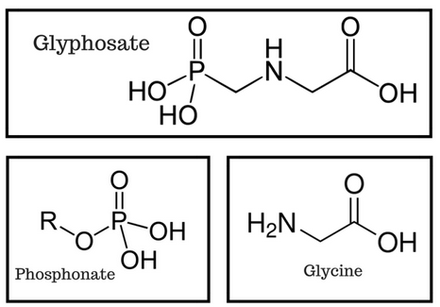
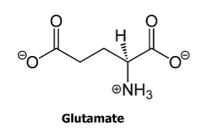
GLYPHOSATE
=active ingredient in the weedkiller RoundUp
-suppresses the shikimate pathway (phenylalanine, tyrosine, tryptophan) of plants and microbes only
=>antibiotic and microbicide
-has structural similarities to GLYCINE and GLUTAMATE

Slide 20
GLYPHOSATE:
The Problem
glyphosate inhibits shikimate pathway of some species (preferable beneficial gut bacteria) in the human gut microbiome [Mesnage et al., 2021]
  microbiome dysbiosis
protein synthesis: glyphosate inserted in place of glycine
  suppresses melatonin synthesis
    disrupts cytochrome P450 enzymes, which are involved in melatonin metabolism
    melatonin is derived from tryptophan: tryptophan-synthesis in plants and microbes is blocked by glyphosate
  suppresses two enzymes (APS (adenosine 5’-phosphosulfate) kinase and PAPS (3’-phosphoadenosine 5’-phosphosulfate) reductase) involved in sulfate activation and metabolism
  Cytochrome P450 (CYP) enzymes dysfunction in the gut, liver, and kidneys leads to impaired supply of serotonin, melatonin and sulfate to the brain.
  Vitamin D activation is a two-step process [Wikvall, K. (2001) Cytochrome P450 Enzymes in the Bioactivation of Vitamin D to Its Hormonal Form. International Journal of Molecular Medicine, 7, 201-209.]
    liver: CYP-mediated (1 microsomal and 1 mitochondrial CYP-enzyme) oxidation to 25(OH)D3 (calcidiol)
    kidneys: CYP-mediated (1 microsomal and 1 mitochondrial CYP-enzyme) oxidation to 1,25(OH)2D3 (calcitriol)

Slide 21
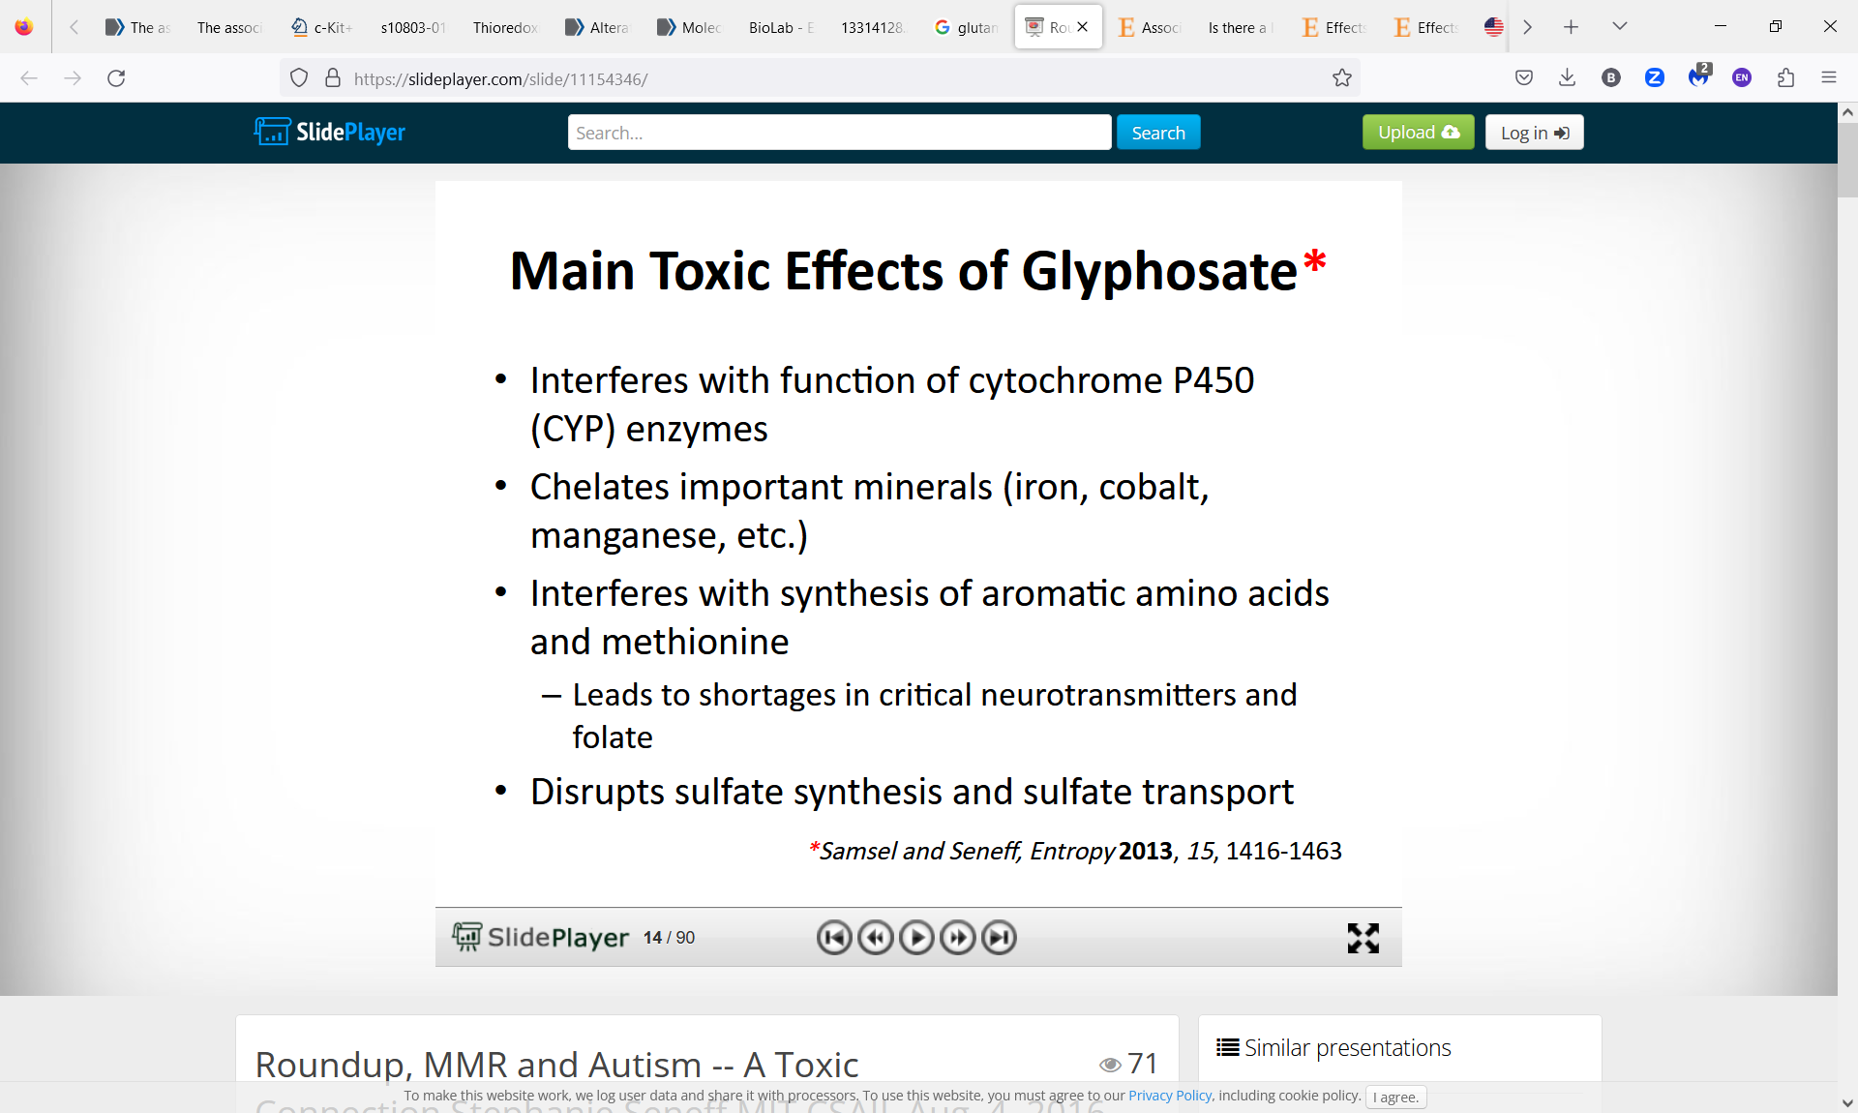
https://slideplayer.com/slide/11154346/

Slide 22
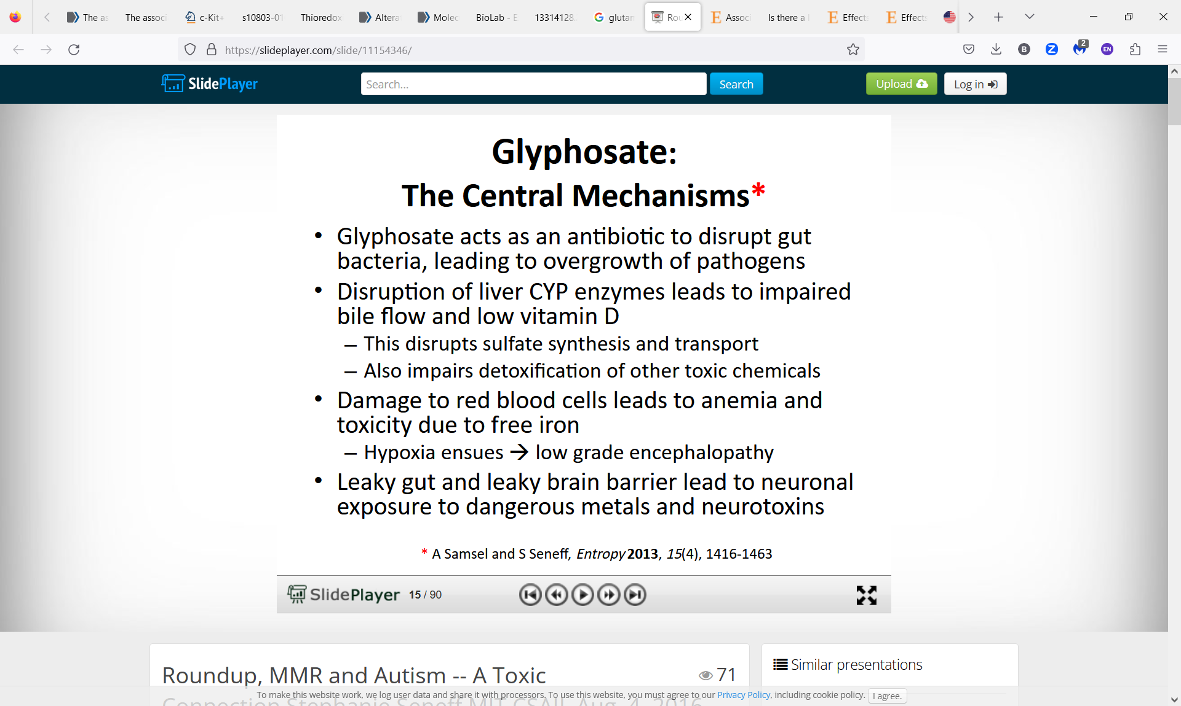

Slide 23
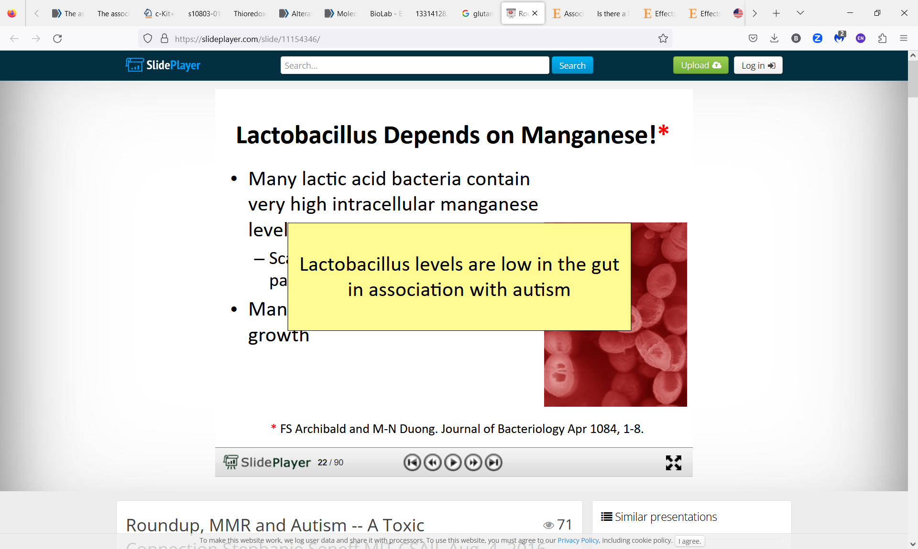

Slide 24
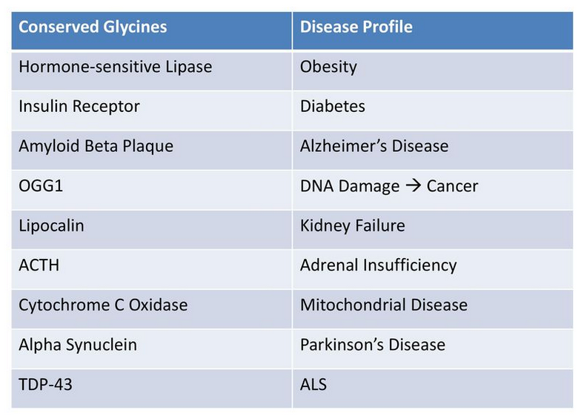
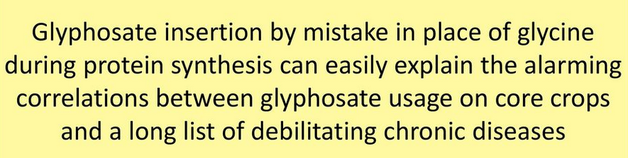

Slide 25
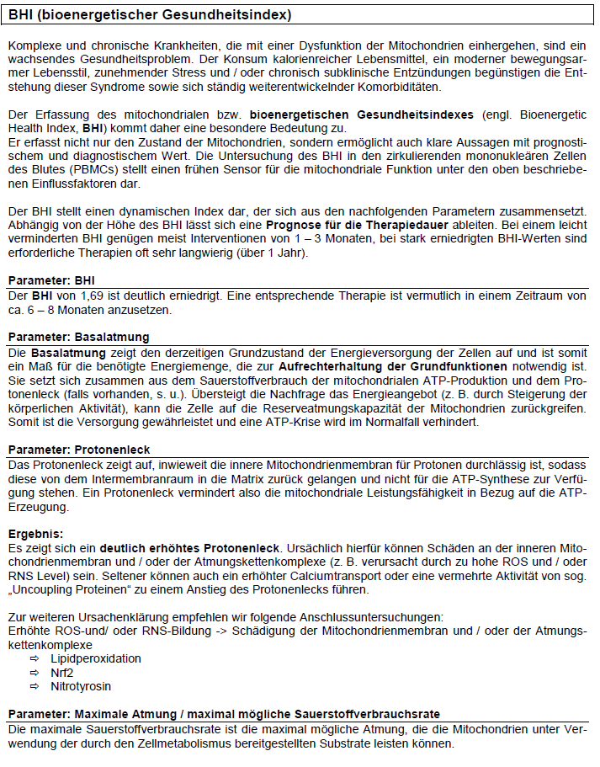
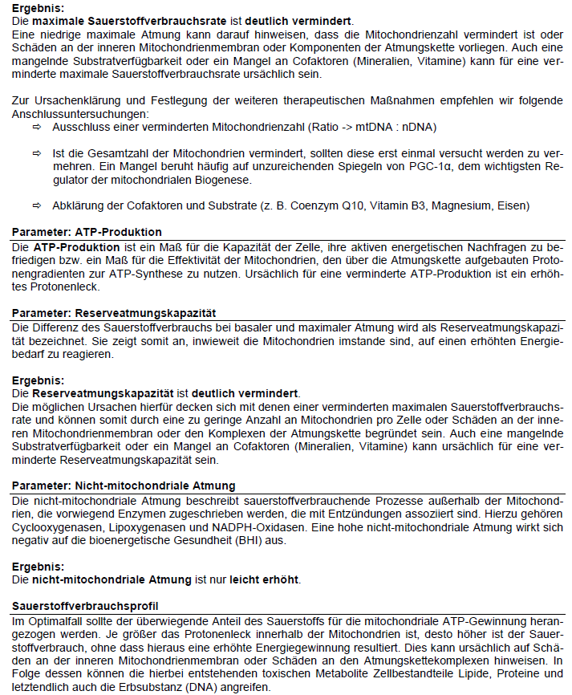

Slide 26
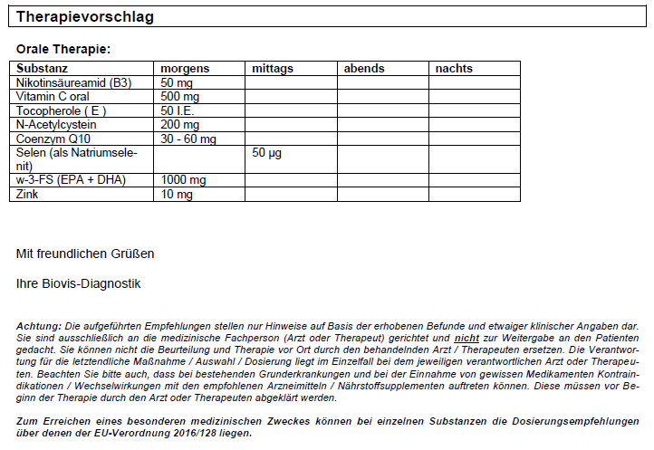
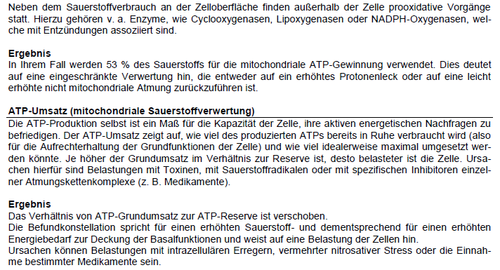

Slide 27
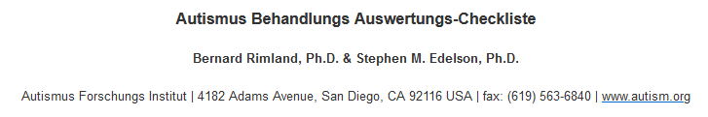
Autism Treatment Evaluation Checklist (ATEC)
ATEC besteht aus insgesamt 77 Items (0-179 Punkten), die in 4 Untergruppen unterteilt sind:
  Kommunikation/Sprache (14 Items mit je 0-2 Punkten; 0-28 Punkte)
  Geselligkeit (20 Items mit je 0-2 Punkten; 0-40 Punkte)
  Sensorisches / kognitives Bewusstsein (18 Items mit je 0-2 Punkten; 0-36 Punkte)
  Gesundheit / Körperliches / Verhalten (25 Items mit je 0-3 Punkten; 0-75 Punkte) wie Schlafprobleme, Krampfanfälle, Magen-Darm-Probleme usw.
  Je höher die Punktezahl, desto schwerer der Ausprägungsgrad der Autismus-Symptomatik!
  ATEC wird von Eltern, Lehrern oder Betreuern in ca. 15 Minuten ausgefüllt
  ATEC dient zur Behandlungsbewertung von Autismus,
    ist aber kein diagnostisches Tool, da es die Wirkung der Behandlung im Gegensatz zur Diagnose von Autismus misst
    dient als Score (Gesamt- und Untergruppen-Score), also eine Punktzahl, eine Verlaufskontrolle (Vergleich zwischen unterschiedlichen Zeitpunkten).
ATEC kann seit 2013 frei über die Website des Autism Research Institute
heruntergeladen werden (https://survey.alchemer.com/s3/6068112/8e8f97ecfd26)
Mahapatra S, Khokhlovich E, Martinez S, Kannel B, Edelson SM, Vyshedskiy A. Longitudinal Epidemiological Study of Autism Subgroups Using Autism Treatment Evaluation Checklist (ATEC) Score. J Autism Dev Disord. 2020 May;50(5):1497-1508. doi: 10.1007/s10803-018-3699-2. PMID: 30062397; PMCID: PMC7211200.
Geier, D. A., Kern, J. K., & Geier, M. R. (2013). Ein Vergleich der Autism Treatment Evaluation Checklist (ATEC) und der Childhood Autism Rating Scale (CARS) zur quantitativen Bewertung von Autismus. Zeitschrift für psychische Gesundheitsforschung bei geistigen Behinderungen, 6 (4), 255-267.
Die Einteilung bzgl. Ausprägungsgrad der Autismus-Symptomatik wurde von Mahapatra et al. 2020 übernommen.
  0-20 Punkte: keine/ sehr geringe Autismus-Symptomatik
  21-49 Punkte: milde Autismus-Symptomatik
  50-79 Punkte: moderate Autismus-Symptomatik
  80-179 Punkte: ausgeprägte Autismus-Symptomatik
Mahapatra S, Khokhlovich E, Martinez S, Kannel B, Edelson SM, Vyshedskiy A. Longitudinal Epidemiological Study of Autism Subgroups Using Autism Treatment Evaluation Checklist (ATEC) Score. J Autism Dev Disord. 2020 May;50(5):1497-1508. doi: 10.1007/s10803-018-3699-2. PMID: 30062397; PMCID: PMC7211200.

Slide 28
AUTISMUS SPECTRUM DISORDERS (ASD)
= neurodevelopmental disorder
with multifactorial etiology and the following core symptoms (American Psychiatric Association, 2013):
communication deficit
social interactions deficits
sensory perception disorders
stereotypical behavior

Slide 29
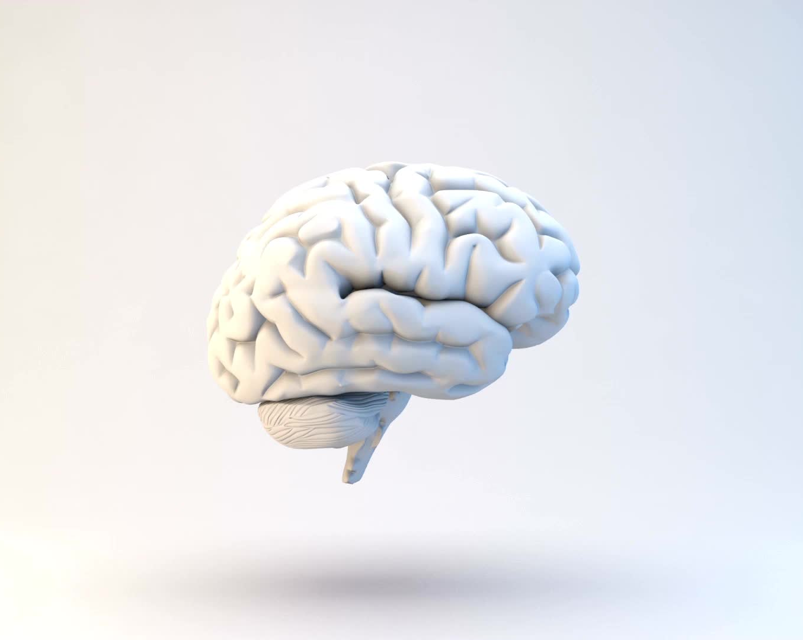
Are ASD mental disorders (psych) or biological/neurological disorders (brain)?
It's time to clear up a misunderstanding.
Autism is NOT a mental disorder or mental illness, although it comes with its own labels and stigmas and is still diagnosed as a 'psychological disorder' (since there are no biological/neurological/cell-based biomarkers available yet).
Since autistic people do NOT 'choose' to behave the way they do, autism is actually not a mental illness either!!!
There is no known psychological factor proven to cause autism.
However, there are links to biological and neurological differences in the brain, suggesting a biological/genetic as opposed to psychological component.

Slide 30
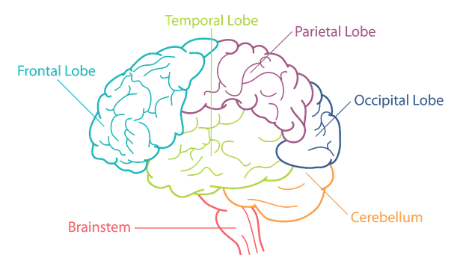
EMF
genetics
toxins
birth-related factors
BRAIN
gut
epigenetics
? Cause or consequence?
Immuno-
dysregulation
changes in structure and function
Mitochondrale
Dysfunction
Cell-based therapies
AUTISM SPECTRUM DISORDERS
Neuro-inflammation
Oxidative Stress

Slide 31
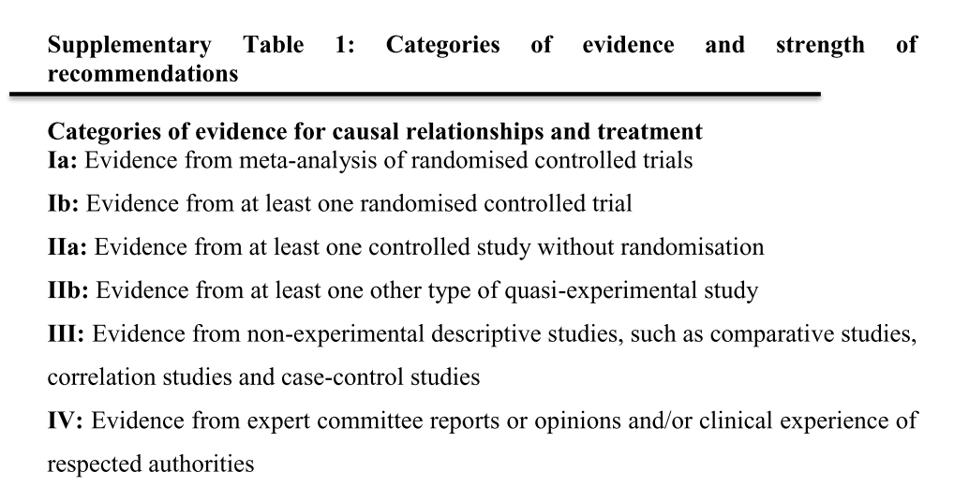
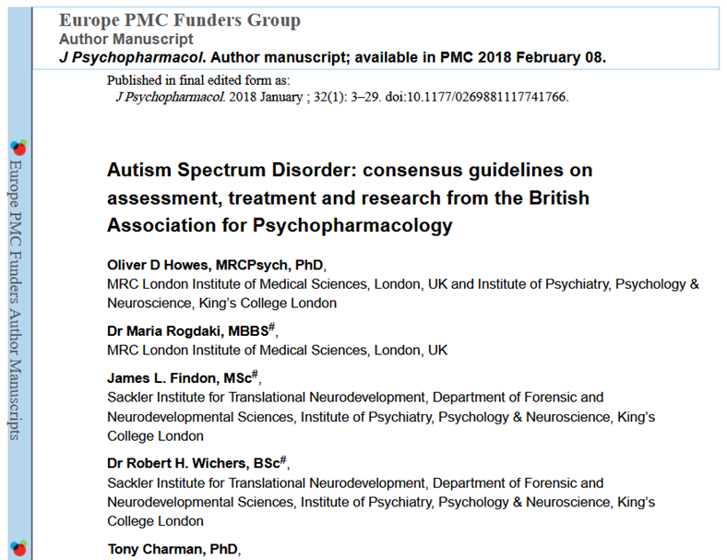
SCIENCE:
Levels of evidence for causal relationships and treatment

Slide 32
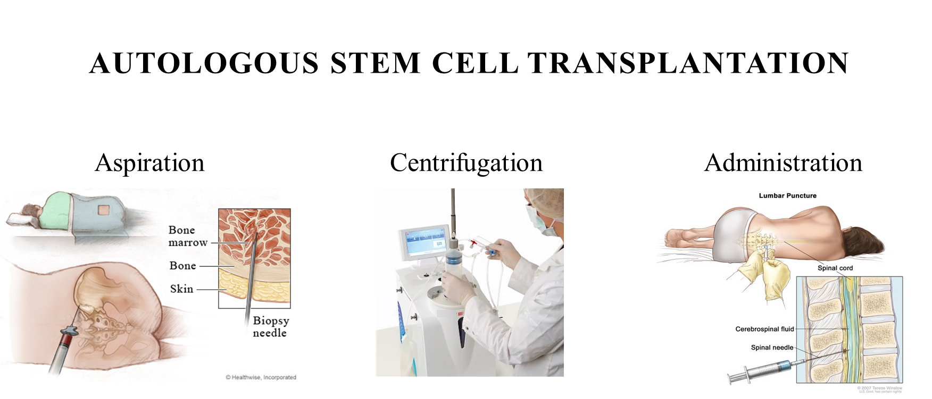

Slide 33
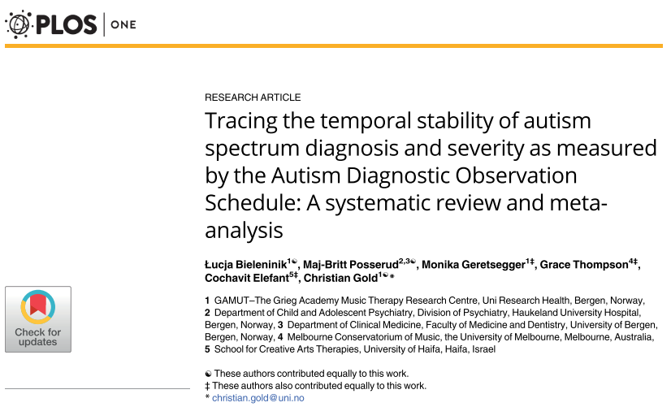
Meta-Analyse:
‚Standard-Therapien‘ mittels ADOS
ADI-R (Autism Diagnostic Interview-Revised)
and ADOS (Autism Diagnostic Observation Schedule)
=gold standard (worldwide) to diagnose ASD!
This meta-analysis showed that ADOS only improved in 18% with 'standard therapy' (from autism to ASD) and remained stable otherwise.
  →'Standard therapies’ (reported as 'standard care', 'carer training’, or 'specific’) were not able to achieve any improvement in most cases (82%)!
  →ADOS is not be suitable for measuring the course of therapy!

Slide 34
Cytochrome P450 (CYP)
The active site of CYPs contains a heme-iron center. The iron is tethered to the protein via a cysteine thiolate ligand.
Human CYPs are primarily membrane-associated proteins^{[19]} located either in the inner membrane of mitochondria or in the endoplasmic reticulum of cells. CYPs metabolize thousands of endogenous and exogenous chemicals. Some CYPs metabolize only one (or a very few) substrates, such as CYP19 (aromatase), while others may metabolize multiple substrates.
CYP enzymes are present in most tissues of the body, and play important roles in hormone synthesis and breakdown (including estrogen and testosterone synthesis and metabolism), cholesterol synthesis, and vitamin D metabolism.
CYP enzymes also function to metabolize potentially toxic compounds, including drugs and products of endogenous metabolism such as bilirubin, principally in the liver.
The Human Genome Project has identified 57 human genes coding for the various cytochrome P450 enzymes.^{[20]}

Slide 35
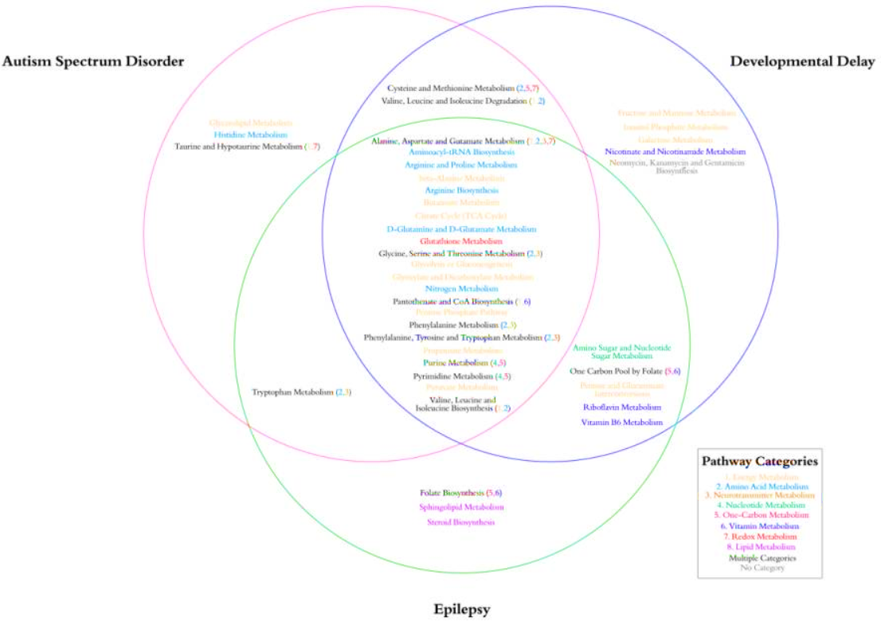
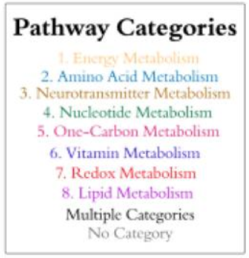
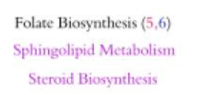
Cerebrospinal fluid analysis
[Brister D, Werner BA, Gideon G, McCarty PJ, Lane A, Burrows BT, McLees S, Adelson PD, Arango JI, Marsh W, Flores A, Pankratz MT, Ly NH, Flood M, Brown D, Carpentieri D, Jin Y, Gu H, Frye RE. Central Nervous System Metabolism in Autism, Epilepsy and Developmental Delays: A Cerebrospinal Fluid Analysis. Metabolites. 2022 Apr 20;12(5):371. doi: 10.3390/metabo12050371. PMID: 35629876; PMCID: PMC9148155.]

Slide 36
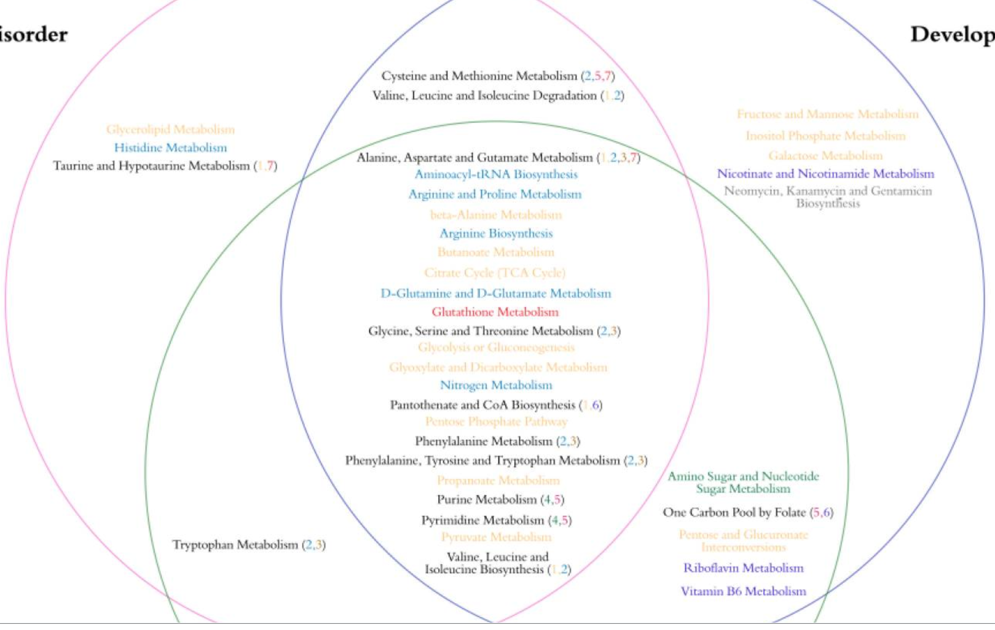

Slide 37
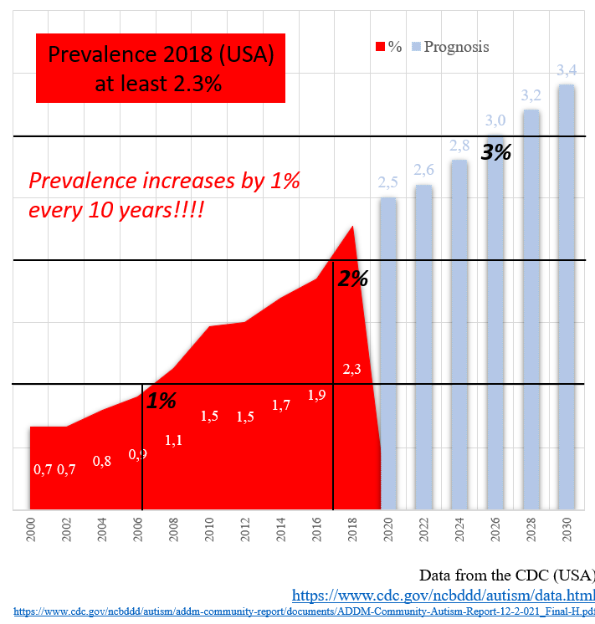
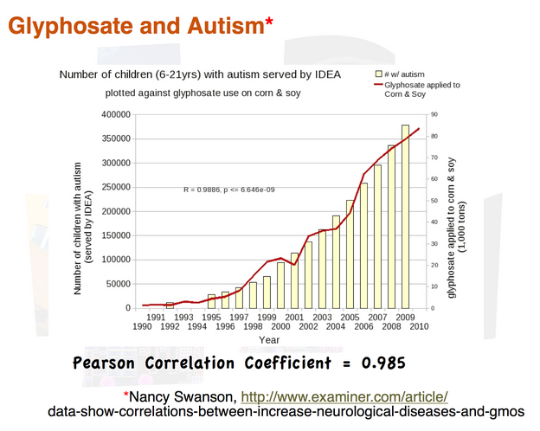

Slide 38
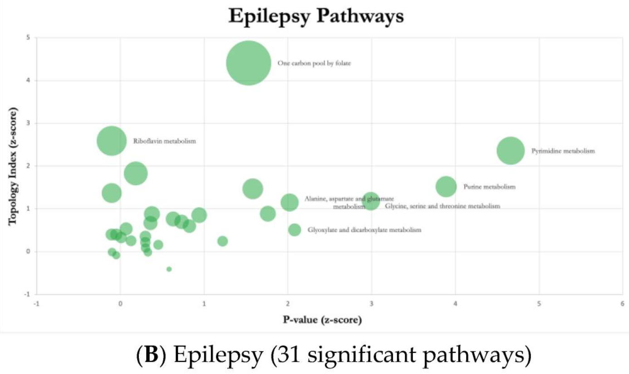
Cerebrospinal fluid analysis
[Brister D, Werner BA, Gideon G, McCarty PJ, Lane A, Burrows BT, McLees S, Adelson PD, Arango JI, Marsh W, Flores A, Pankratz MT, Ly NH, Flood M, Brown D, Carpentieri D, Jin Y, Gu H, Frye RE. Central Nervous System Metabolism in Autism, Epilepsy and Developmental Delays: A Cerebrospinal Fluid Analysis. Metabolites. 2022 Apr 20;12(5):371. doi: 10.3390/metabo12050371. PMID: 35629876; PMCID: PMC9148155.]

Slide 39
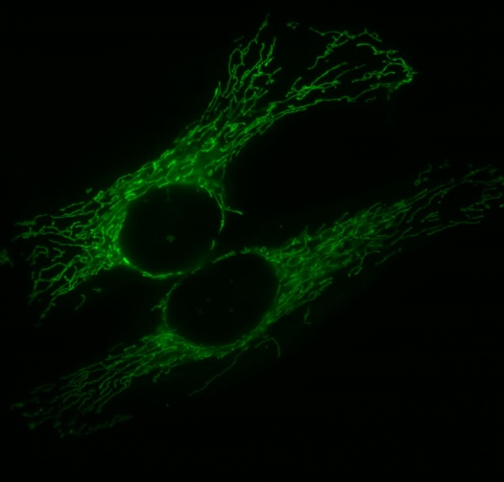
Zellbasierte Behandlungen:
Regenerative Medizin (Wirkungshypothese)
Im Knochenmark → gesunde mtDNA (mitochondrale DNA)
  Transfer/In Stammzellen: mtDNA umgibt nDNA (nukleäre DNA) → Informationsaustausch (krank->gesund) via Transkriptionsfaktoren
  Mitochondriale Spaltung (fission)
  = der Prozess, bei dem sich Mitochondrien teilen oder in zwei separate mitochondriale Organellen trennen.

